Slide 1
Magnetometer Calibration
2 Wheels 2 Furious
Scott Clemens

Slide 2
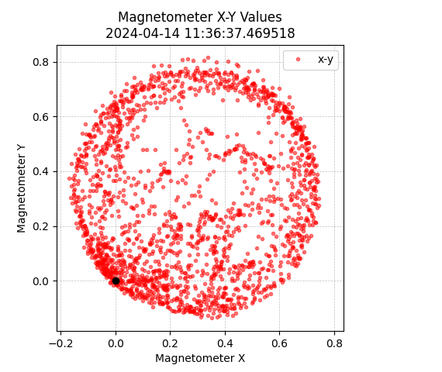
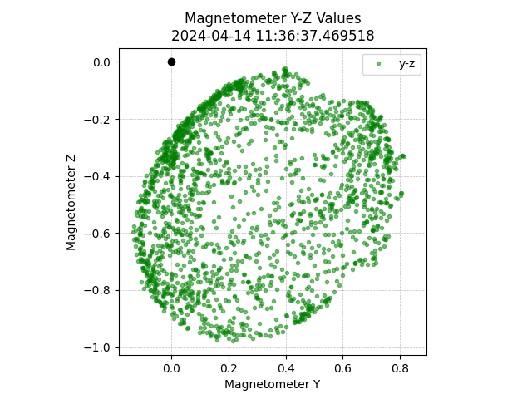
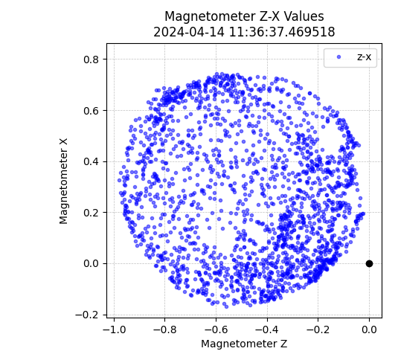
Raw Magnetometer Data
BEFORE CALIBRATION
Circular and offset from origin
Oval and offset from origin
Circular and offset from origin
Origin is the black dot.

Slide 3
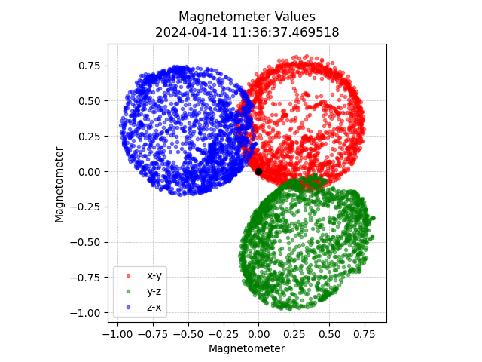
Combined Raw Data
BEFORE CALIBRATION
Three axis are not aligned due to offsets in raw values. Ideal outcome is to have three overlapping circles with center at the origin.
X data max = 0.744 min = -0.168 range = 0.912 average = 0.262
Y data max = 0.815 min = -0.137 range = 0.952 average = 0.276
Z data max = -0.024 min = -0.979 range = 0.956 average = -0.462
X-Y data h = 0.295 k = 0.35 a = 0.285 b = 0.291 a/b = 0.98
Y-Z data h = 0.336 k = -0.513 a = 0.288 b = 0.294 a/b = 0.979
Z-X data h = -0.518 k = 0.304 a = 0.29 b = 0.281 a/b = 1.031
Origin is the black dot.

Slide 4
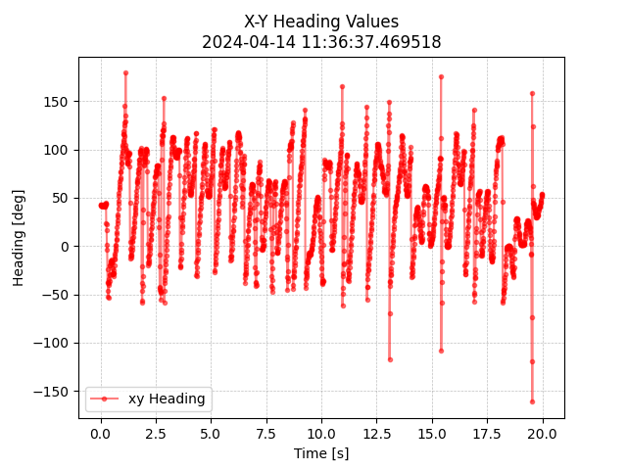
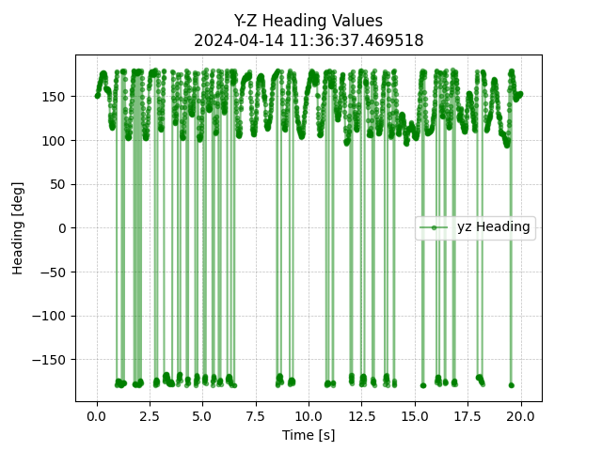
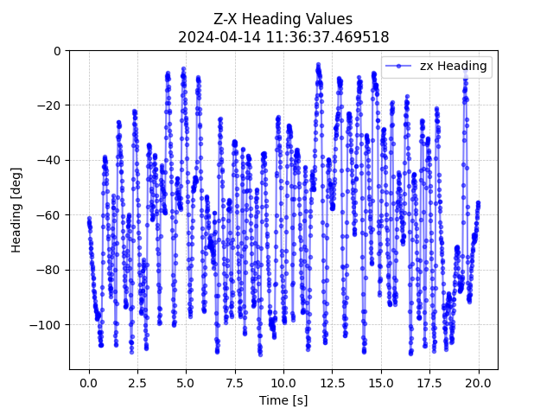
Raw Heading Data
BEFORE CALIBRATION
Rollover present due to proximity to +180 degrees

Slide 5
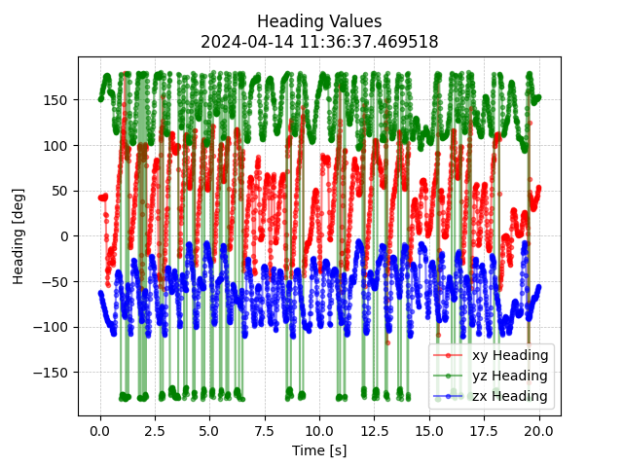
Combined Heading Data
BEFORE CALIBRATION

Slide 6
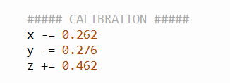
Initial Calibration Method
Add/subtract average value in real-time to raw values to shift magnetometer circle center to origin

Slide 7
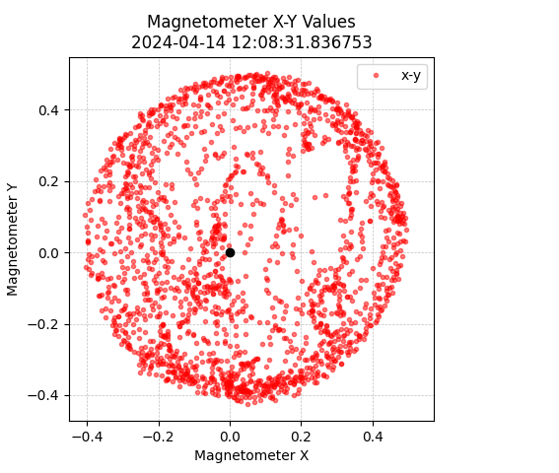
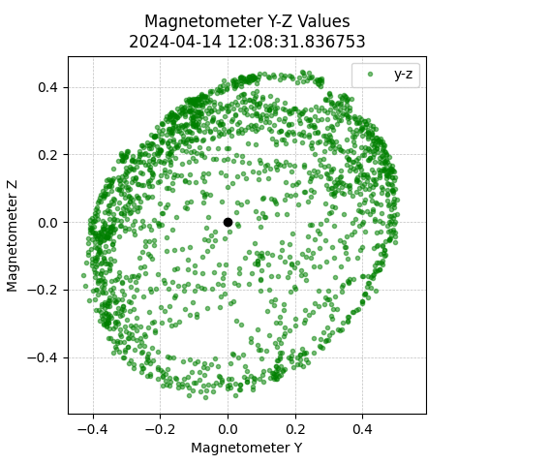
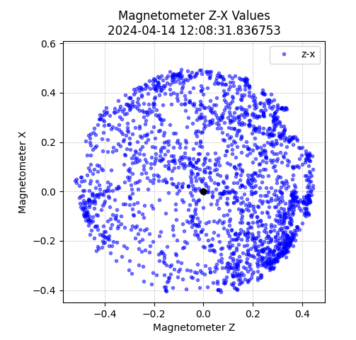
Raw Magnetometer Data
INITIAL CALIBRATION
Circular and slight offset from origin
Oval and slight offset from origin
Circular and slight offset from origin
Origin is the black dot.

Slide 8
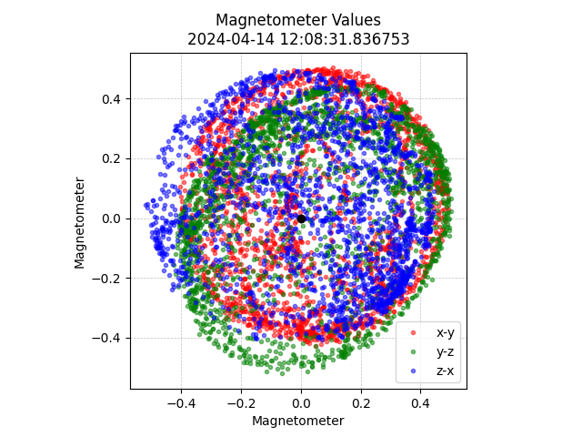
Combined Raw Data
INITIAL CALIBRATION
Three axis are better aligned due to correction of offsets in raw values.
X data max = 0.494 min = -0.405 range = 0.899 average = 0.043
Y data max = 0.503 min = -0.426 range = 0.929 average = 0.02
Z data max = 0.444 min = -0.52 range = 0.964 average = 0.051
X-Y data h = 0.062 k = 0.056 a = 0.271 b = 0.292 a/b = 0.928
Y-Z data h = 0.058 k = -0.059 a = 0.297 b = 0.301 a/b = 0.985
Z-X data h = -0.043 k = 0.029 a = 0.293 b = 0.279 a/b = 1.051
All h and k values (center) are closer to 0
Origin is the black dot.

Slide 9
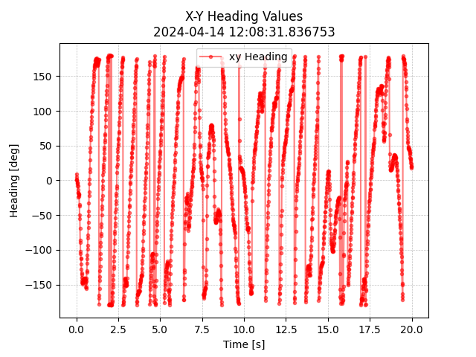
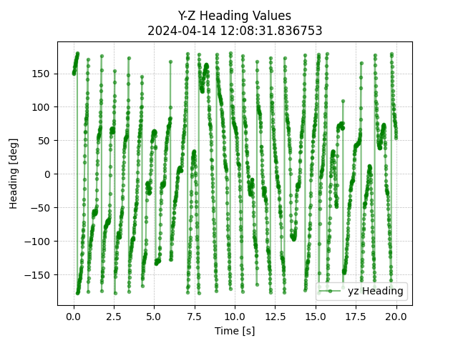
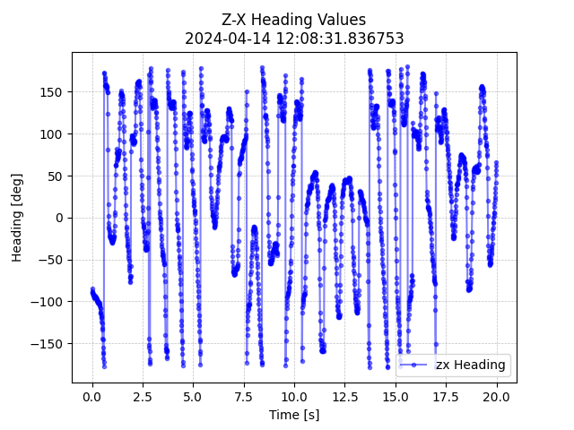
Combined Heading Data
INITIAL CALIBRATION
No more rollover present due to shifting raw values

Slide 10
Final Calibration Method
2. Scale data by ratio of i_range to average of j_range and k_range values
X_range/[(Y_range + Z_range)/2] = 0.949
Y_range/[(Z_range + X_range)/2] = 0.997
Z_range/[(X_range + Y_range)/2] = 1.0547

Slide 11
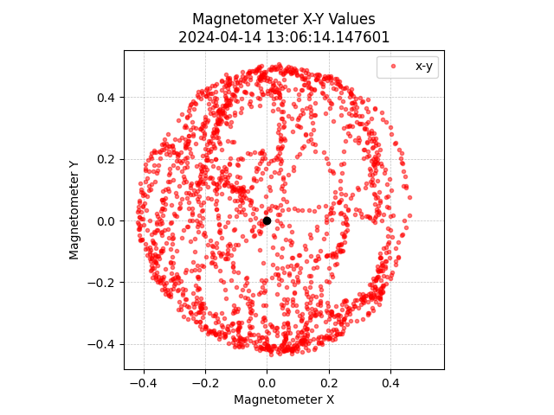
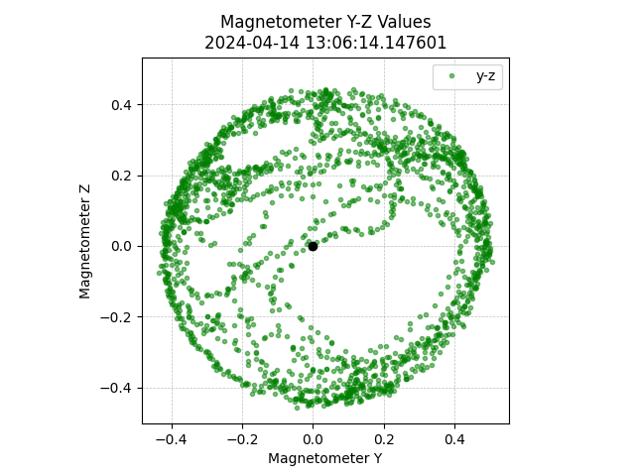
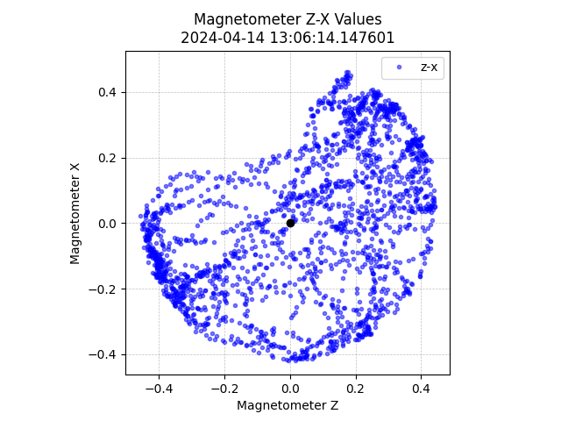
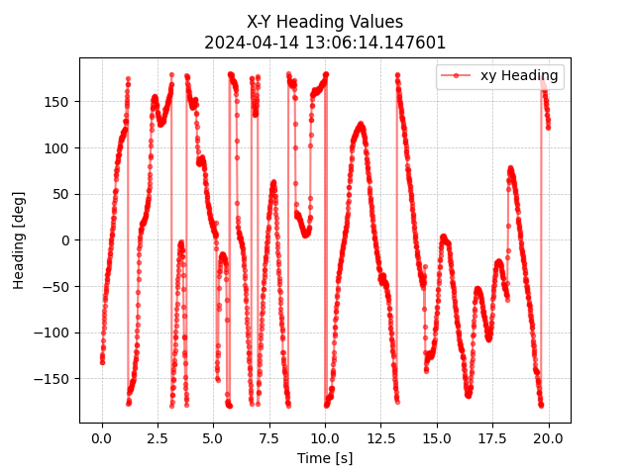
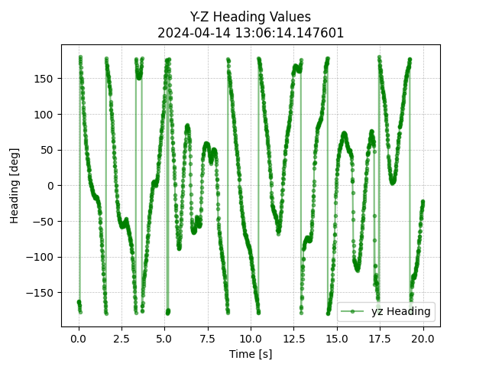
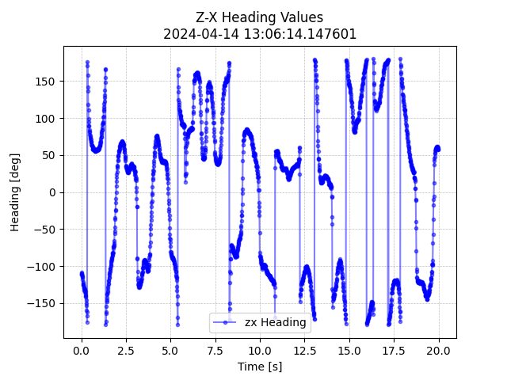
Payload Raw Data
BEFORE CALIBRATION

Slide 12
Payload Raw Data
BEFORE CALIBRATION
X data max = 0.463 min = -0.419 range = 0.881 average = -0.004
Y data max = 0.506 min = -0.435 range = 0.942 average = 0.026
Z data max = 0.442 min = -0.458 range = 0.9 average = 0.037
X-Y data h = 0.036 k = 0.03 a = 0.264 b = 0.296 a/b = 0.893
Y-Z data h = 0.042 k = -0.017 a = 0.304 b = 0.279 a/b = 1.09
Z-X data h = -0.026 k = 0.044 a = 0.281 b = 0.284 a/b = 0.99

Slide 13
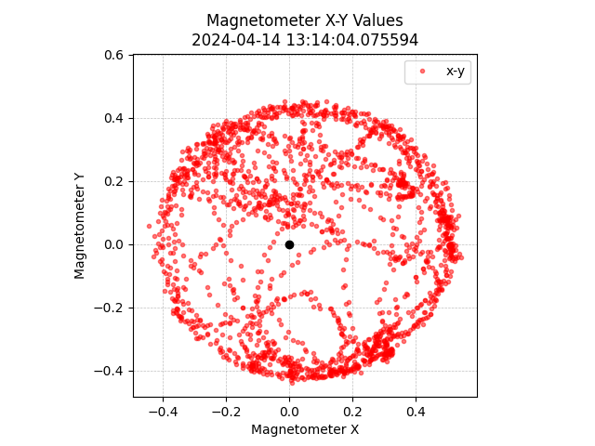
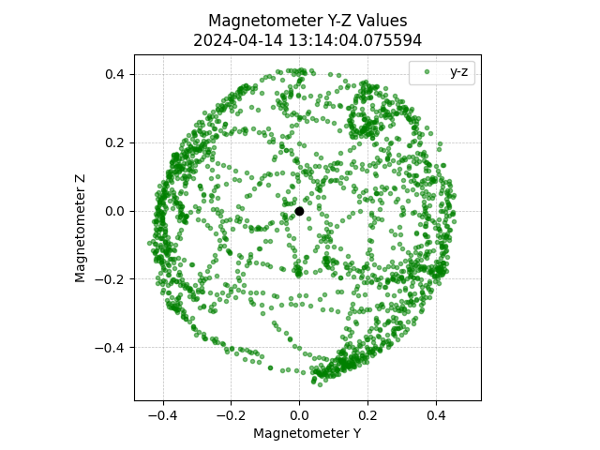
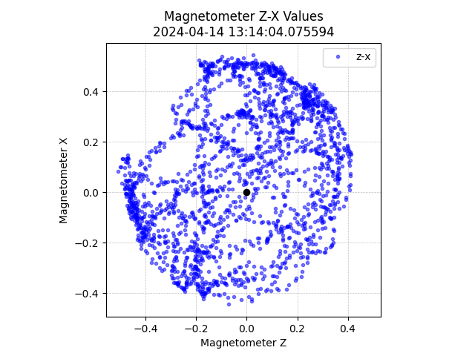
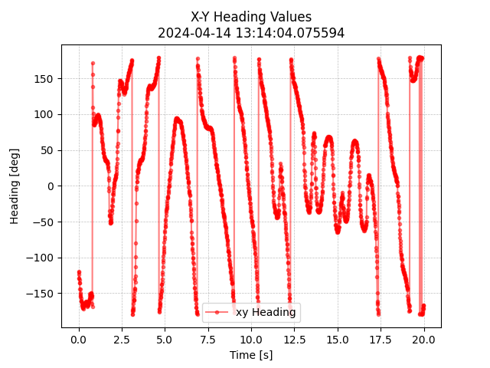
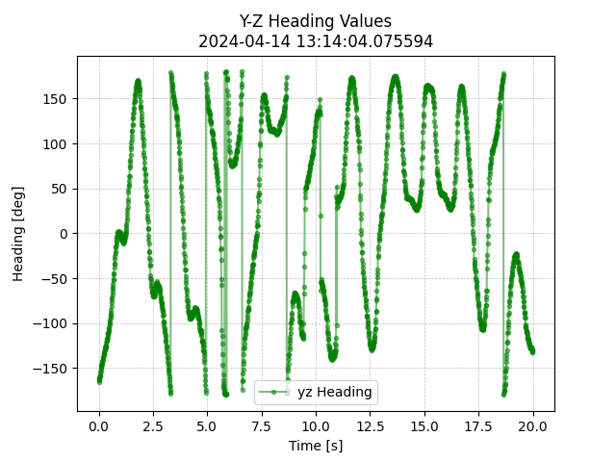
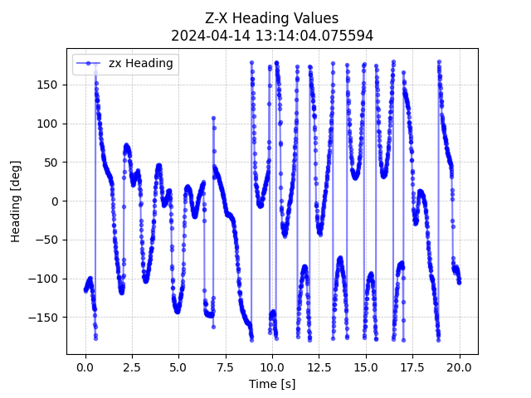
Payload Raw Data
AFTER CALIBRATION

Slide 14
Payload Raw Data
AFTER CALIBRATION
X data max = 0.463 min = -0.419 range = 0.881 average = -0.004
Y data max = 0.506 min = -0.435 range = 0.942 average = 0.026
Z data max = 0.442 min = -0.458 range = 0.9 average = 0.037
X-Y data h = 0.036 k = 0.03 a = 0.264 b = 0.296 a/b = 0.893
Y-Z data h = 0.042 k = -0.017 a = 0.304 b = 0.279 a/b = 1.09
Z-X data h = -0.026 k = 0.044 a = 0.281 b = 0.284 a/b = 0.99
X data max = 0.544 min = -0.444 range = 0.988 average = 0.082
Y data max = 0.453 min = -0.439 range = 0.892 average = 0.023
Z data max = 0.412 min = -0.51 range = 0.922 average = -0.032
X-Y data h = 0.055 k = -0.004 a = 0.304 b = 0.277 a/b = 1.095
Y-Z data h = 0.001 k = -0.05 a = 0.276 b = 0.285 a/b = 0.969
Z-X data h = -0.043 k = 0.055 a = 0.276 b = 0.292 a/b = 0.944

